Slide 1

Curiously Conjuring 2021 Crime
Researched and compiled by
The Curious Conquerors
-Alisha -Mischa -Lindsay

Slide 2



Meet the Curious Conquerors
Alisha
I am a mom of an 8 month old and another on the way. My children’s father and I are engaged and plan to be married in October.
I currently work as a 911 dispatcher. I am originally from Florida, and then lived in Colorado, Idaho, California, and now Texas.

Slide 3
Meet the Curious Conquerors
Lindsay
At Home: I was born and raised in a small town in Northern Iowa. My hometown is where I still reside. I am close to my family and friends. I do not have children, just 3 dogs and a lot of plants.
Personally: I am shy, creative, intuitive, and loves doing anything hands on.
At work: I work in customer service. I know how to communicate effectively to coworkers and managers when necessary.
My future: I have always had a drive for technology and have plans to pursue a technology based career down the road.

Slide 4


Meet the Curious Conquerors
Mischa
First meet
Nervous, Shy, goofy, fast
At work
I am known to be every team’s go-to training and know-how expert.
Direct, formal, confident
At Home
I inspire my two daughters
by modeling:
Student
Family Member
Fulfilling Career
Motivation
Love for information and a better understanding of data to improve life.

Slide 5
Why crime rates vs prison rates?
With Alisha being an emergency dispatcher for a Sheriff’s office in Texas, we first attempted to do our project on crime rates within the country she works in. However, we were not able to access the data we desired in the timeframe needed, and so we decided to see what crime data we could find and go from there.
We were able to find a plethora of data and worked to wrangle the data to narrow down what we wanted to use. Some of the data we found involved individual states and their violent and property crime rates, and so we

Slide 6
Methods

Slide 7


Extraction and Preparation
Find
Drop
Rename
Format
merge
Prison
Police

Slide 8

Analytics
Descriptive
Statistical
Modeling
R
Python

Slide 9
Are unemployment rates correlated with crime rates?
Pearson’s Regression
Python

Slide 10
How does the unemployment rate affect the correlation between police reports and prison rates?
Step Wise Linear Regression
R

Slide 11
Visualizations
Tableau
R

Slide 12
Results

Slide 13
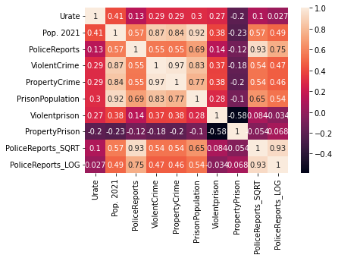

Slide 14
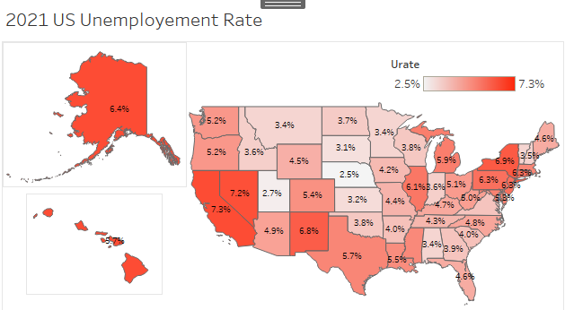
Unemployment rate vs Crime rate
Unemployment histogram in final workbook, is that normal when it has 2 spikes?
Texas with significantly high unemployment rate
log histogram of police reports still skewed?
Texas and florida with significantly high police reports, iowa avg

Slide 15
Summary

Slide 17
Conclusion

Slide 18
This is just the beginning!
Time factor
State size factor
Politics
Health care

Slide 19
Questions?

